Slide 1
Development of Image Analysis Algorithms for Crack Detection Using a Smartphone Mounted in a Car
(SnapCrack)
By: Akira DeMoss, Maggie Dalton, Modeste Kenne, Nik Thota
Advisor: Halil Ceylan
Client: Bo Yang
Team Name: sdmay20-18
Website: http://sdmay20-18.sd.ece.iastate.edu/
Notes:
Modeste

Slide 2
Project Need/Goal
Problem: The detection and classification of cracks and potholes found on roads currently require a manual measurement of the affected areas. Researchers have to exit their vehicles and enter the roadway, which is often dangerous and time consuming.
Project Goal: Remove the need for researchers to leave their vehicles to gather data.
Methodology: Use a smartphone mounted in a vehicle to gather and classify data using machine learning algorithms.
Notes:
Modeste

Slide 3
Market/Literature Survey
Mobilenet SSD has been used to detect various road anomalies including alligator cracking, crosswalks
YOLO has been used on a desktop to detect various road anomalies.
Publically available datasets
Notes:
Akira

Slide 4
Our Solution
Detect cracks in real-time using mobile-device powered object detection
Send images to a server and store in database
Visualize crack locations and modify labels through a web application
Notes:
Akira

Slide 5
Functional Requirements
Android Application
Detect potholes, longitudinal and transverse cracks
Save images of detected cracks to the server, including their location
API
Provide detailed API error responses
User Interface
The app should not require any further interaction from the user once the road scan begins
The app should display bounding boxes around detected cracks/potholes to provide visual feedback of detections
Notes:
Modeste

Slide 6
Non-functional Requirements
Android Application
Detect cracks/potholes on various types of roads
Detect cracks/potholes at multiple driving speeds
Classify cracks/potholes per the Long-Term Pavement Performance Program (LTPP) distress manual
API:
The API should have documentation for each endpoint
User Interface
If the classification server is not available, the user interface should display a message indicating a loss of communication to the user
The user should be capable of viewing past detections along with their data
Notes:
Modeste

Slide 7
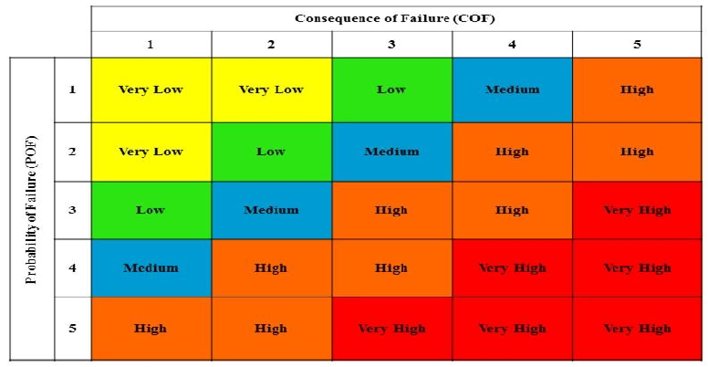
Risk Identification & Mitigation
Notes:
Akira

Slide 8
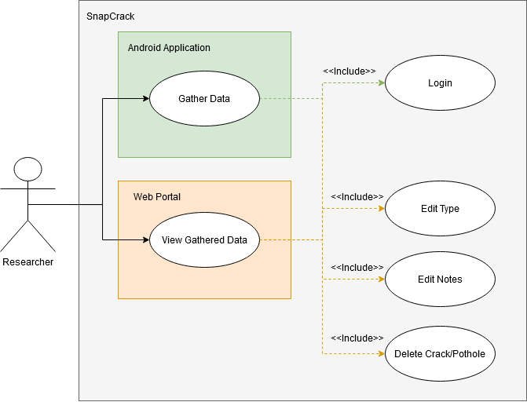
Use Cases
Notes:
Maggie

Slide 9
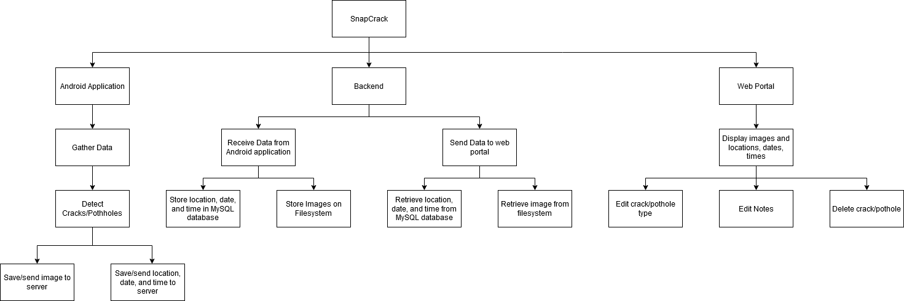
Functional Decomposition
Notes:
Maggie, referenced https://www.tutorialspoint.com/software_testing_dictionary/functional_decomposition.htm and sddec19-14’s presentation

Slide 10
Resources/Cost Estimate
Android Device → API 27+ ~ Google Pixel 4 XL $600
3rd Party Phone Mount ~ $20 - $25
Computer with Node.js and MySQL installed
Images stored on filesystem
Web Browser

Slide 11
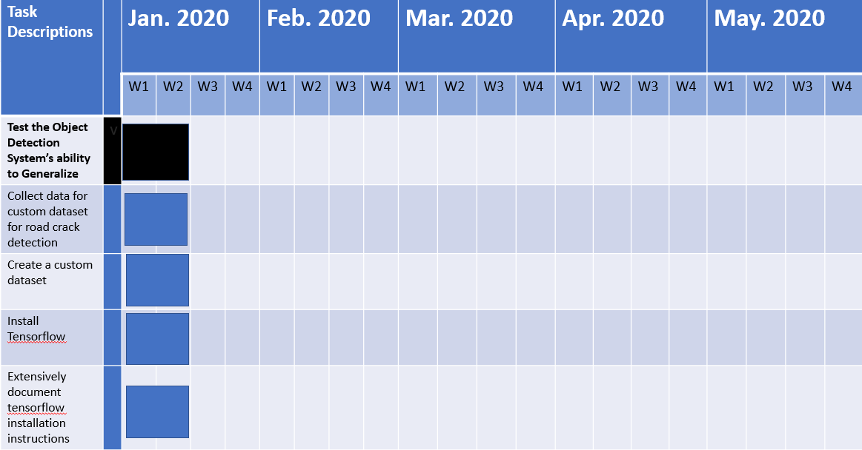
Project Milestones & Schedule
Snapcrack - Sdmay20-18

Slide 12
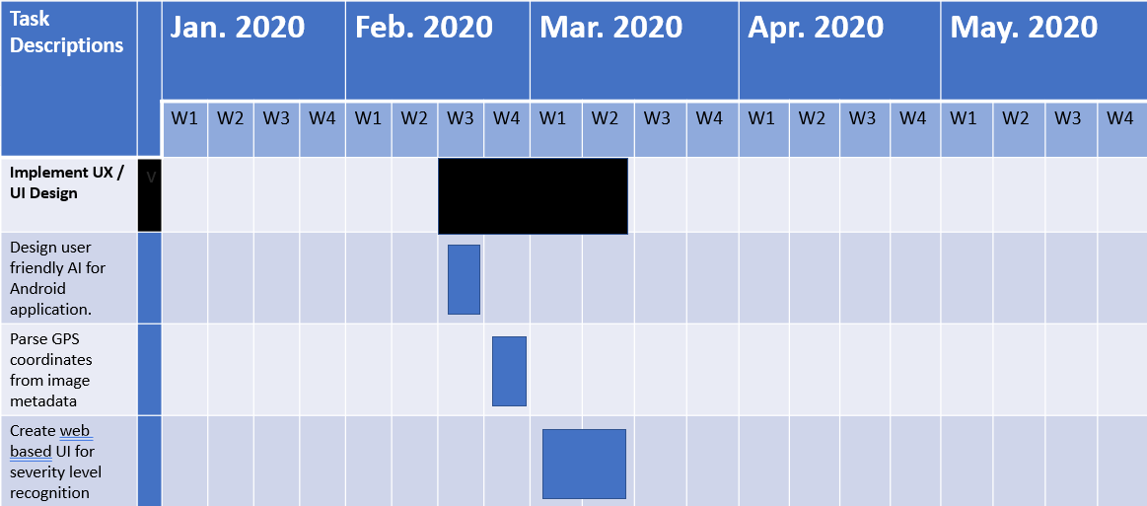
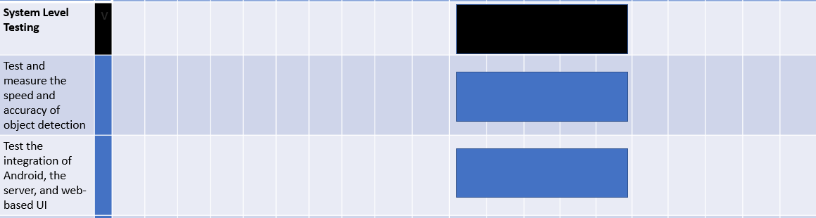
Snapcrack - Sdmay20-18

Slide 13
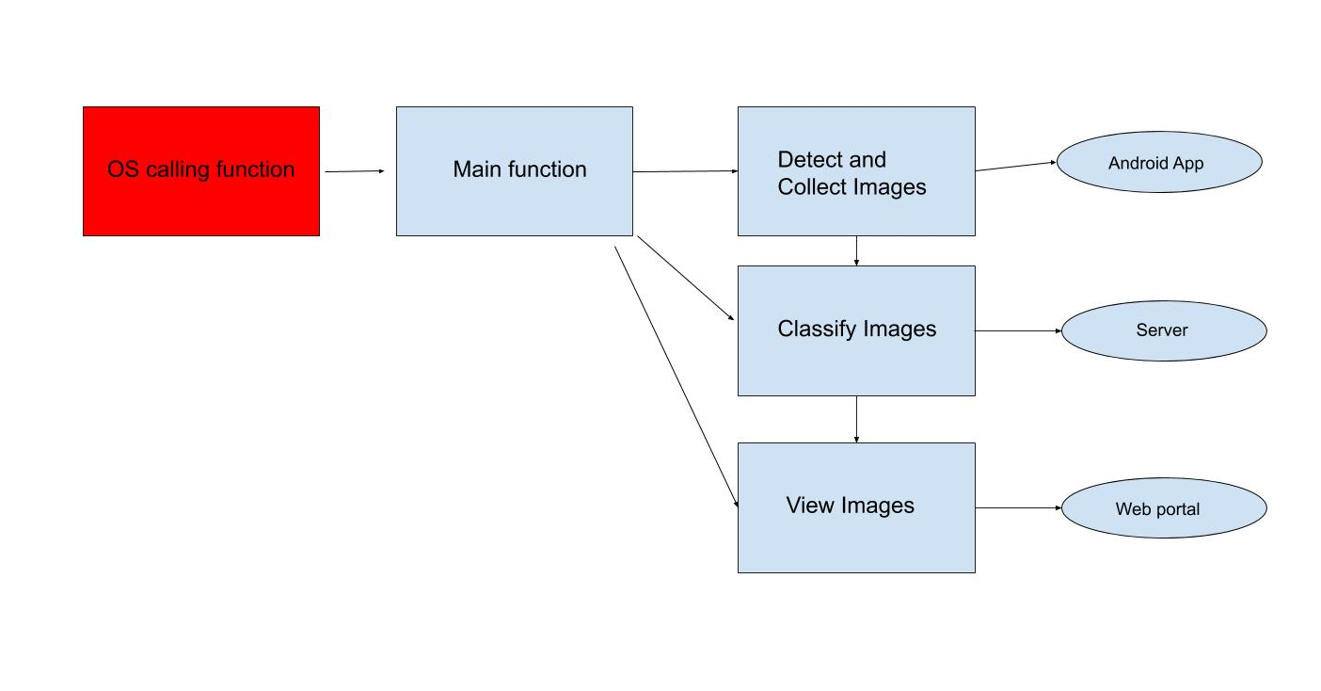
Detailed Design / Modules Design
Notes:
Nik

Slide 14
Build - Platforms & Technologies
Back-End
Ubuntu VM
MySQL
Node.js
Algorithm
TensorFlow
OpenCV
CUDA
Android
TensorFlow Lite
Volley
Java/Kotlin
Web Portal
React
JavaScript/HTML/CSS
Notes:
Maggie

Slide 15
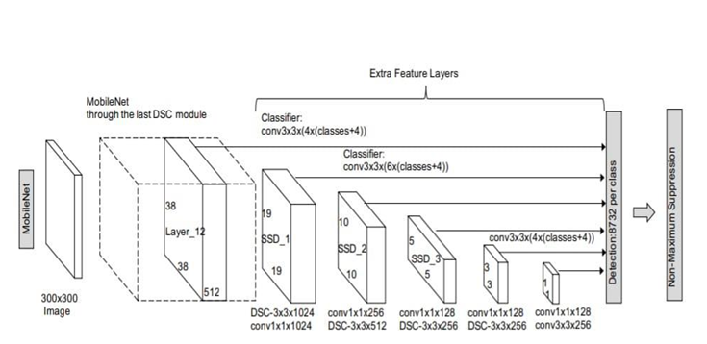
Implementation Detail -> Algorithm
Standard convolution both filters and combines inputs into a new set outputs in one step
Depthwise Separable Convolution (DSC) splits this into two layers
Filtering layer
Combining layer
SSD Mobilenet leverages the DSC module for feature extraction and the base architecture of the Single Shot Detector to achieve fast real-time detection on mobile devices.
Convolutional Neural Network Architecture: SSD Mobilenet
Notes:
Akira

Slide 16
Implementation Detail -> Android Application
TensorFlow Lite
Allows on-device inferencing
Android CameraX Library
Greater support for ML
Volley Library
Easier & Faster HTTP Requests
Notes:
Maggie

Slide 17
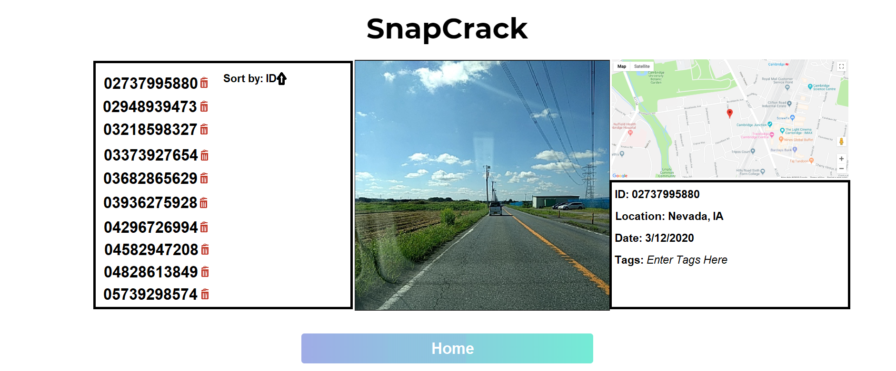
Implementation Detail -> Backend/Web Portal
Node.js Server
Non-blocking
Fast
MySQL Database
Easy to use and install
React
Easier, more professional UI

Slide 18
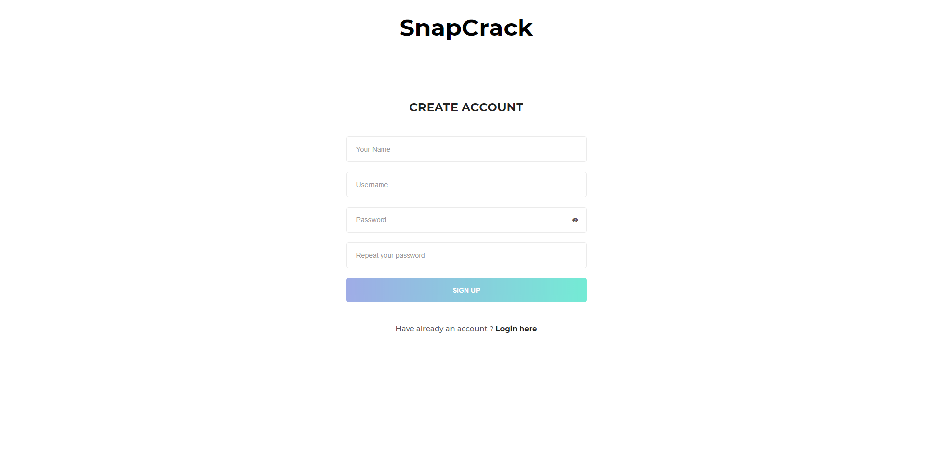
User Interface Design
Sleek and Simple Design
Notes:
Nik

Slide 19
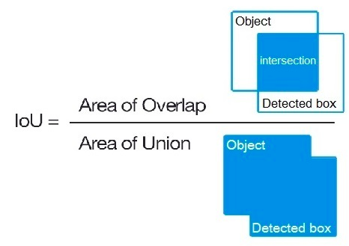
How We Tested
Datasets
Training data: 1405 images, 3055 labels
Testing data: 350 images, 756 labels
Mean Average Precision (mAP) Performance Benchmark
Intersection over Union (IoU) = Area of intersection / Area of union
True positive (TP): IoU > 0.5
False positive (FP) IoU <= 0.5
Precision = TP / (TP + FP)
Mean Average Precision (mAP) =
Notes:
Akira

Slide 20
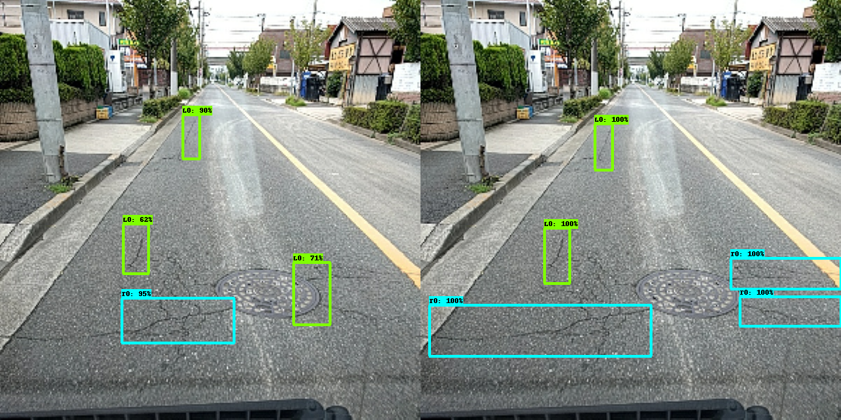
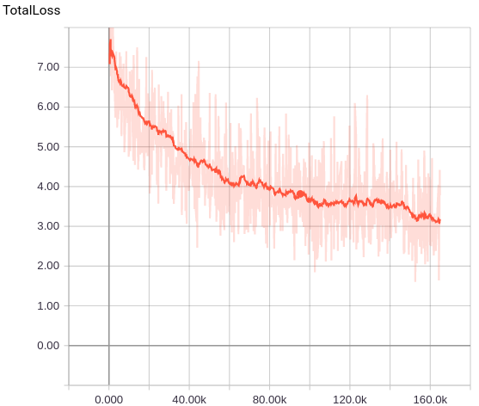
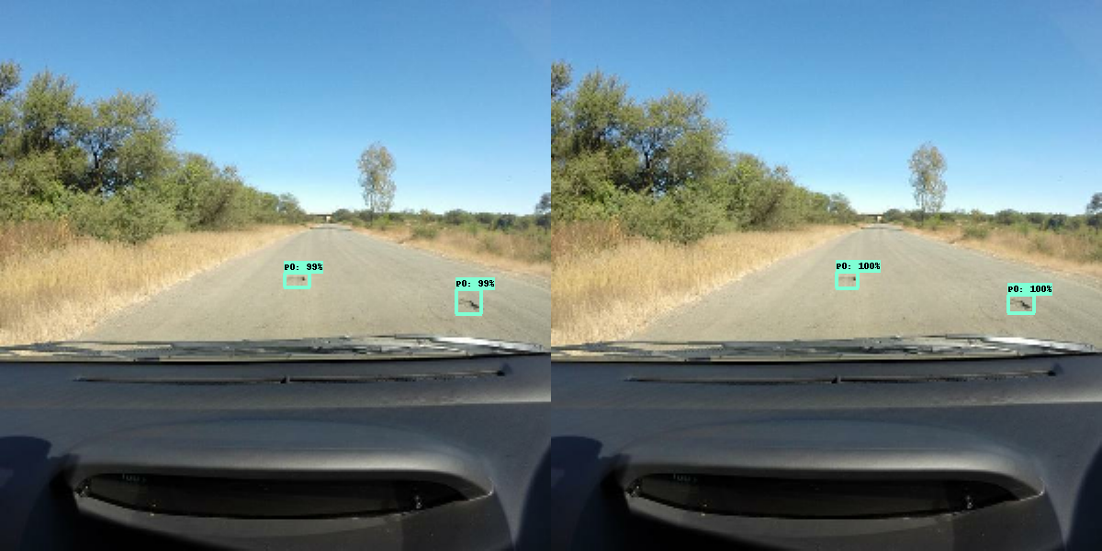
Testing
Notes:
Akira

Slide 22
Prototype vs. Final Product
Prototype:
Proof of concept for object detection
Was able to make some detections when tested on videos from Iowa
Pre-existing dataset contained extraneous and mislabeled data
Final Product:
Detect cracks in real-time using mobile-device powered object detection
Send images to a server and store in database
Visualize crack locations and modify labels through a web application
Notes:
Akira

Slide 23
Design Tradeoffs
Speed vs. Accuracy Tradeoff
Pros
Faster detections
Real-time detection
Improved scalability
Improved usability
Positive developer experience
Cons
mAP could be higher
Notes:
Akira

Slide 24
Conclusions & Lessons Learned
Our project may prove to be useful to civil engineers wishing to survey road conditions
Trimmed features to stick to schedule and keep realistic expectations
Removed severity classification
Gave us more time to focus on more important functions
Our project came together well, however there is potential for improvement
Notes:
Nik

Slide 25
Engineering Standards & Design Practices
Standardized Tooling and Technologies
Agreed on tools and technologies
Standardized Coding Style
Defined conventions for coding
Process Standards
Agreed on development steps
Notes:
Modeste

Slide 26
Responsibilities
Akira Demoss: Deep Learning Developer
Maggie Dalton: Android Developer
Modeste Kenne: Server Developer
Nik Thota: Web Developer
All: Image gatherer/labeler
Notes:
Modeste

Slide 27
Future Work
Potential updates with a more accurate model
Severity classification
More crack types
Alligator
Fatigue
Fillings
Specific crack identified in
web portal
Test with civil engineers and consider their feedback
Notes:
Nik

Slide 28
Questions?

